Slide 1
BANK MARKETING BY: MARAM ALZHRANI

Slide 2
CONTENT:
Introduction.
Project goal.
Modelling.
Data process.
Conclusion.

Slide 3
Introduction:
Companies build many marketing campaigns to increase subscribed persons.
Many companies work on analyzing the market before starting campaigns, and the prediction of subscriptions size and classify of the audience are considered as the basic points in their work.
Machine Learning algorithms have shown remarkable performance on several classify and prediction tasks

Slide 4
Project goal:
to predict and anticipate the client’s cases in terms of whether he will subscribe to a deposit or not based on his /her information. were based on phone calls.

Slide 5
Modelling:
Using Logistic Regression algorithms to classify the clients.
classifiers used to classify the clients :
- Random Forest .
- Naive Bayes

Slide 6
Data process
Read dataset
Check dataset have missing value (cleaning dataset) .
Analysis data .
Check balance.
Split data (train , test).
Build model.
Applying PCA.
Accuracy Score.

Slide 7
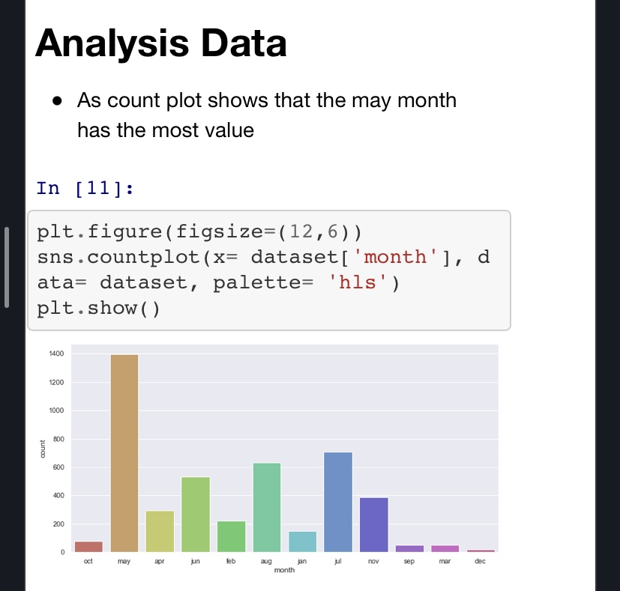
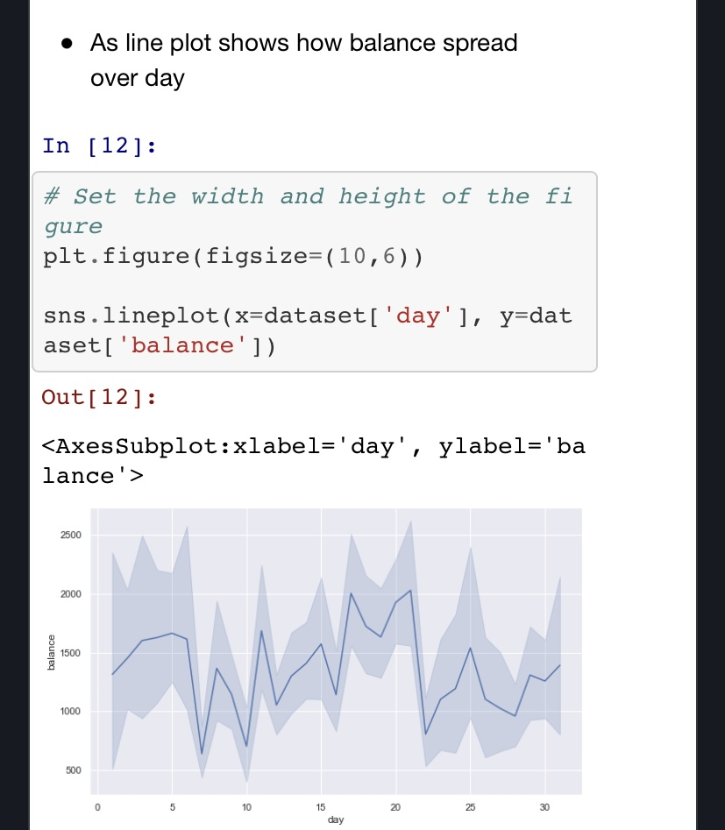
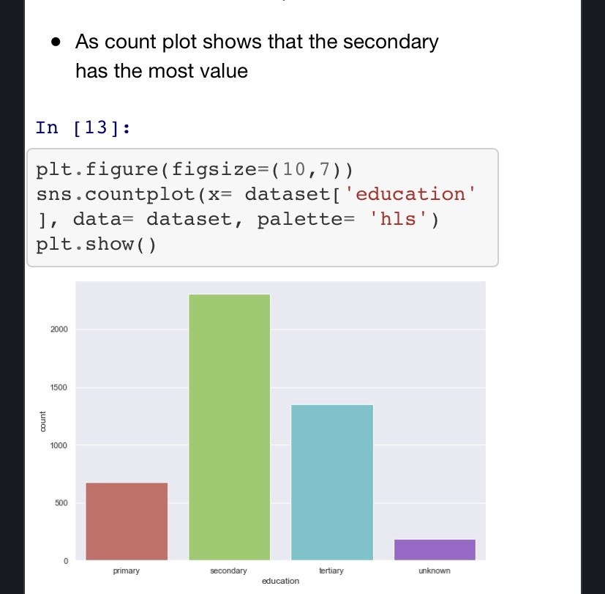
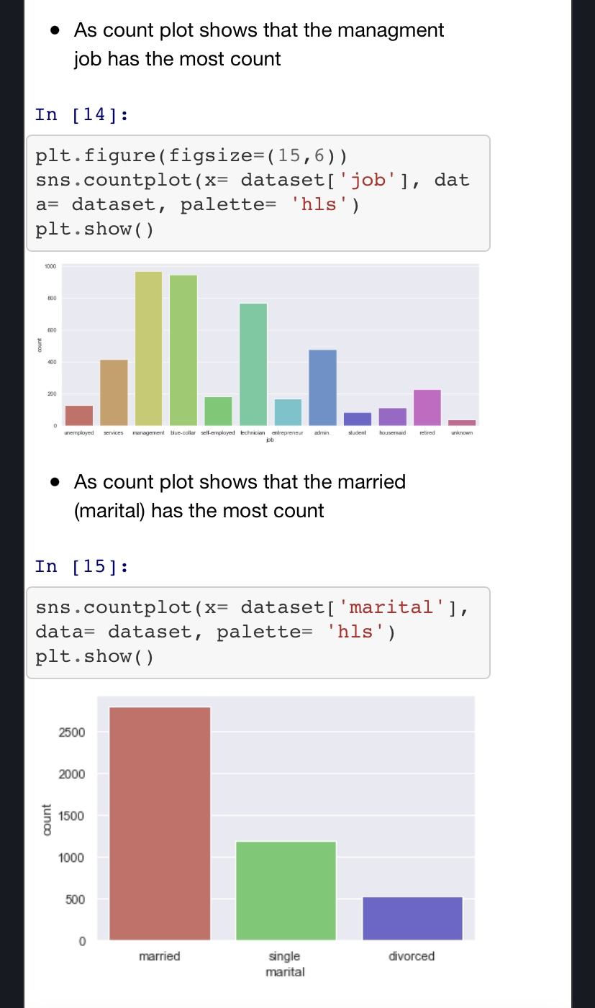

Slide 8
Conclusion
I cleaned and processed the dataset then studied of supervised machine learning algorithm : Logistic Regression, Random Forest and Naive Bayes classifiers to build the models and finally, test the model accuracy.

Slide 9
Thank you

